Slide 1
Working with Resources and R
IN721 2017
Design and Development for Mobile Devices
Session 1.2
Notes:
NB: May be some overlap with Android you did in JavaWithDale. We will move quickly through this material
When using Android, the system creates a special class R.java, through which you access project resources
Today we will take a first look at the code behind and see how we can access and work with these resources programmatically at runtime.

Slide 2
Resources
Layouts
Constants
Image files
Notes:
There are many kinds of resources that you can include in your projects and access from the code behind.
Some are physical (image and audio files; external data files), some are symbolic (e.g. system constants; layout files)
Although the different classes of resource are quite disparate, there are syntactic similarities in how you access and use them in the code behind, which is good.
We will begin with the three major categories and introduce the others as required.
You will know these are the most important ones because AS creates the necessary file structure for you automatically when it creates a Project. For the less common resources, you will have to create your own folders. (Again, we will encounter this later.)

Slide 3
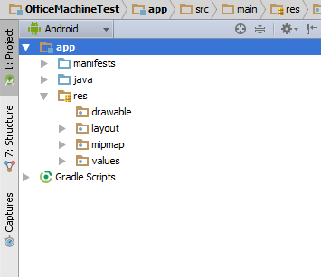
File Structure
Notes:
This is the folder structure you are given. All your project resources will be placed in these folders.
The folder names are fairly self-explanatory: res/drawable is for image files; res/layout is for layout xml files (screen design) and res/values is for project constants.
We will start with layouts…

Slide 4
Layouts
One (or more) layout XML files for each Activity.
Notes:
We have seen these in prac
Why do you think you might need more than one layout file? → Different devices (phone or tablet) and orientations (landscape or portrait).
We will see how to assign layout to screens at runtime depending on the computational context.
We will also have layout files for other visual entities, specifically, the Fragment class family. We meet Fragments later in the paper.
As you continue to build more complicated screens, you will see that the XML that defines them becomes correspondingly more complicated. We will see some examples in the next few practicals.

Slide 5
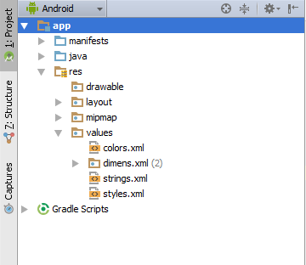
Resource Constants
Rather than coding literal values (in the XML or in the code-behind), you define project constants and code references to them
Notes:
These four files are generated automatically on project creation, an indication that most projects will need to use most of these classes of constants: colours, dimensions, strings and styles. (We will ignore styles for now…)
Using a constant => Instead of typing #FF0000 into the XML as an attribute value, we define a constant “Red” and set its value to #FF0000 in these files, then refer to it as Red in the layout XML (syntax in a moment).
Why does the Android Development group recommend this approach?
For the same reason that we always use constants.
Imagine that you have built an app with a blue background on all its screens and the same blue font for all its controls, and you have typed in the hex value for the client’s chosen shade of blue in dozens of layout files. Then the client decides he wants everything changed to pink. You now get to go in and manually change every reference to that hex value to some new hex value. Since every time you touch running code you introduce the possibility of breaking it, this is bad, bad, bad.
Similar problems can arise with dimensions (e.g. the padding of TextViews or the font size for list items) and strings (e.g. the year on the copyright notice).
So, instead of using literal values, we define constants. These are all defined in XML (Android uses A LOT of XML).
Let’s look….

Slide 6
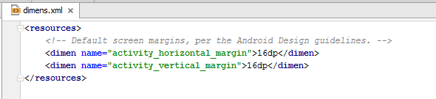

Resource Constants
In an Activity’s layout XML file:
Notes:
Here is an example dimens.xml. Open it by double-clicking in the Package Explorer
This is well-formed XML. The root element is <resources>.
The root contains two <dimen> elements.
Each has a name attribute with an assigned value.
The name attribute is essential, because that is what we use to refer to a resource constant from either the xml or the Java code-behind.
Each <dimen> also has an element value, the content between the open and close tags.
This therefore defines a constant activity_horizontal_margin = 16dp, just like declaring one in a 4G programming language.
Remember in the last practical, we saw how to assign a layout dimension using a literal value? (We actually did padding, but the logic is the same…) You changed the value in the layout xml file, either by editing it directly, and/or by using the Properties pane in Design view. We used a literal for this exercise, as shown. Now we want to use a resource constant.
Assuming your dimens.xml file is as shown above, here is how you refer to the defined resource constant…
Note the syntax:
The value is still expressed as a literal string. This is still XML, and XML doesn’t understand things like variables. It deals exclusively with text, i.e. strings.
You start with the @, which says “I’m about to refer to a resource constant”. Then you provide the XML tag of the entity. You can see that dimensions are defined with the <dimen> XML tag.
NB: This looks like a file path, and you might think you should say “dimens” here because that is the name of the file. This is wrong. At compilation, Android isn’t reading from these files, it is accessing a special class that has been built from these files. In that class (which we will look at in a bit) all the resources are dumped in together – the file structure is lost. What remains is their XML “type”.
Finally, you give the name attribute of the constant, as shown.
Imagine now that you have used this 16dp margin 100s of times in your app, and the client decides he wants an 8dp margin instead. How many things do you change? => Just the one. The entry in the dimens.xml. Much better.

Slide 7
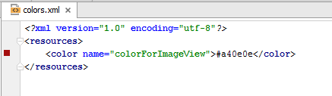
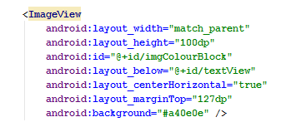
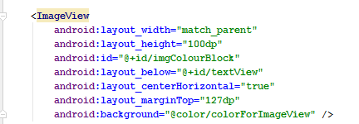
Resource Constants
Notes:
Another example. This makes a coloured rectangle on the screen
First we see the use of a literal
Second we see the use or a resource constant defined in colors.xml
We will leave strings as an exercise.

Slide 8
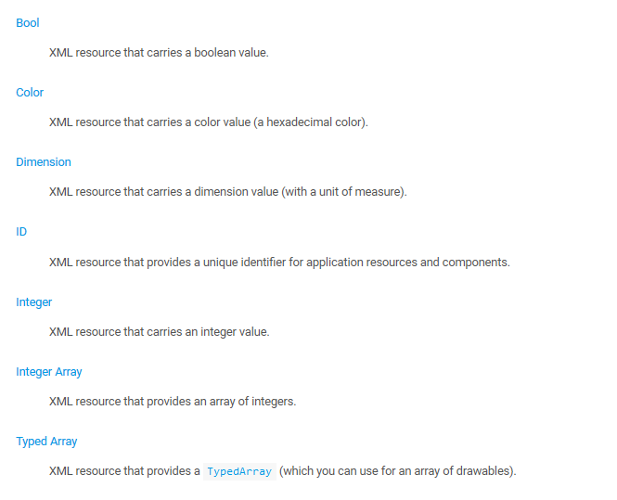
Resource Constants
Notes:
Here are the kinds of resources you can have (From developer.android.com)
They don’t need to cover all possible types separately, because they provide the Typed Array, into which you can dump pretty much anything.
In prac, we will look at one of the array types.

Slide 9
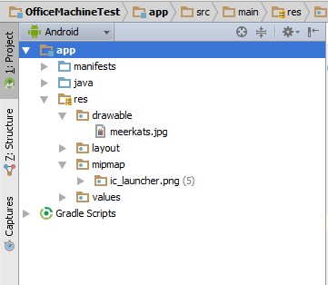
Image Files
Notes:
Image files are a little simpler to work with, actually. You don’t have to write any XML, you just copy and paste your image files into res/drawable
NB: Often you will see subfolders in res/drawable for holding images with different pixel densities for different devices. We will get to that laater.
NB: At this time, you really physically copy and paste. There is no “right-click Import” thing, as you might expect. This may change in later versions of AS.
The Package Explorer will change to look like this…
The syntax for accessing is the same…

Slide 10
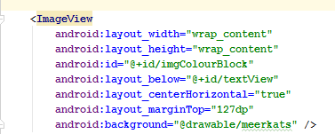
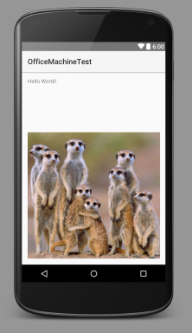
Image Files
Notes:
@drawable/meerkats
NB: This is a resource name, not a file name. Don’t include the .jpg
BTW, when changing from setting a background colour (as before) to setting a background picture, I had to change some other attributes as well. Can you figure out which ones? → layout_width and layout_height.
(What they were before, for comparison)
They will now size to their contents, not be fixed as before. Which approach you choose depends on your layout and design.
We look at the permissible values for the various attributes as we go.
Think about how this is implemented, from a design perspective....

Slide 11
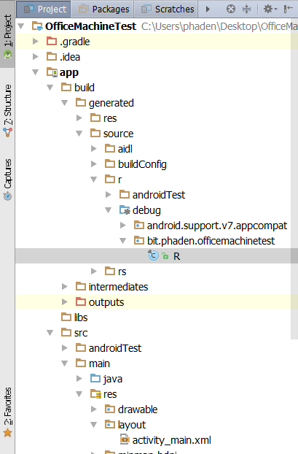
R
Notes:
We’ve mentioned a couple of times that your resources are managed by this class “R”.
(NB: There is another class R.java in the v7 folder. That contains system constants. Never modify it…)
Let’s take a look at R…
I’ve changed the explorer view here to show the actual file structure (use the triangle beside Scratches to change the view), and there’s R….way down there.
Obviously, they have buried it so that it is very difficult to locate. You are not intended to modify R.
But understanding what it looks like can help make some things clearer – especially the next thing we are going to do, which is see how to access screen controls.
So, let’s talk about R.java.
Double-click to open….

Slide 12
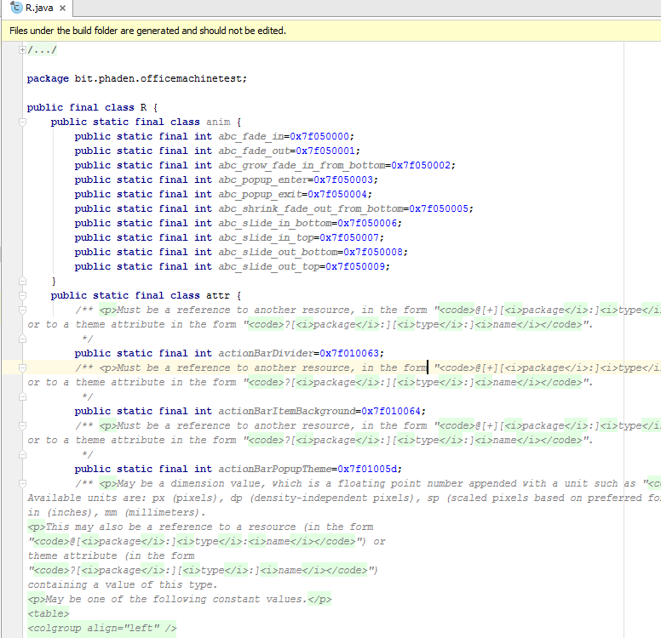
R
Notes:
It’s just a normal Java class that contains a bunch of static constants.
(Explain static constants here, if needed.)
What you see here is just a very small part of R
It goes on and on and on. As an exercise, spend some time with R.
Here’s an interesting bit…

Slide 13
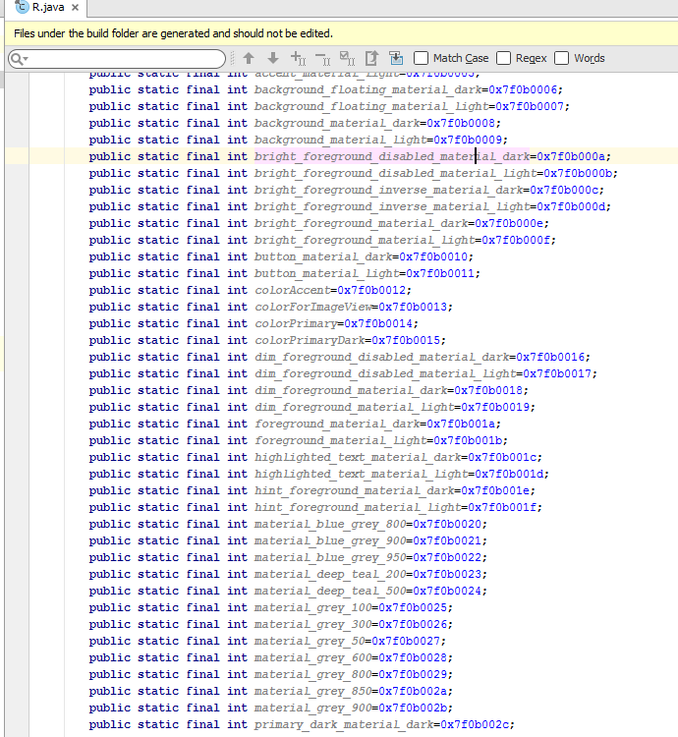
R
Notes:
Remember we defined this <color> element colorForImageView in colors.xml?
If we looked, we could also find the <dimen> that we added.
Note that this constant is an int, not a color. R holds integer IDs.
Each resource constant you add is assigned a big hex integer value. This is their resourceID.
Android gives everything a unique int called a Resource ID and everything that happens at run time depends on these IDs.
Repeat: R doesn’t store the value of the resource constants, it stores their resourceIDs. The system doesn’t want to talk about its resources by their names, it wants to talk about them by their resourceIDs. It’s like when we use your studentID instead of your name.
When we refer to our defined resources (starting with @) in the xml, we get the int – the resourceID
Later we will look at how we can use the constant resourceID to get the constant value (like #FF0000 or 16dp).
But first, let’s think about screen controls (buttons, TextViews, etc.)
Screen controls are also managed via their resource Ids.

Slide 14
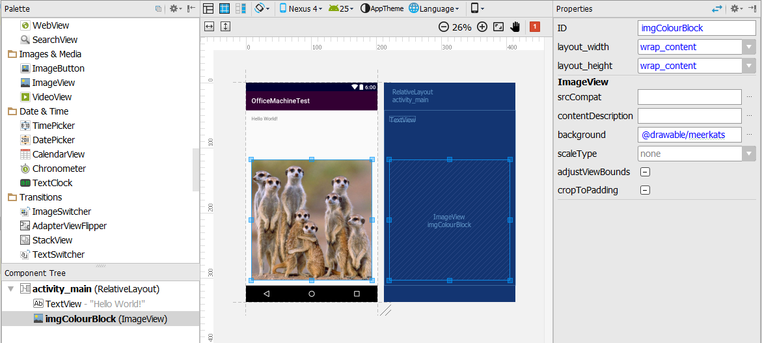
Screen Widgets
Notes:
(Android controls are often referred to as “widgets” – but note there are other things called widgets. We will discuss a bit more later.)
Here is how I set up the ImageView in my version of the Prac we did last time…
Note that I changed its ID property in the Properties window, and that this is reflected in the Component Tree.
The id here is not the ID that R contains (an unfortunate ambiguity). This id is its name – how you identify it in the code behind (you will need to do this to fetch its resourceID).
As with all variable names it should be set to something meaningful. Don’t end up with Button2, Button3, Button4... in your code.
Here is what the xml layout file looks like…

Slide 15
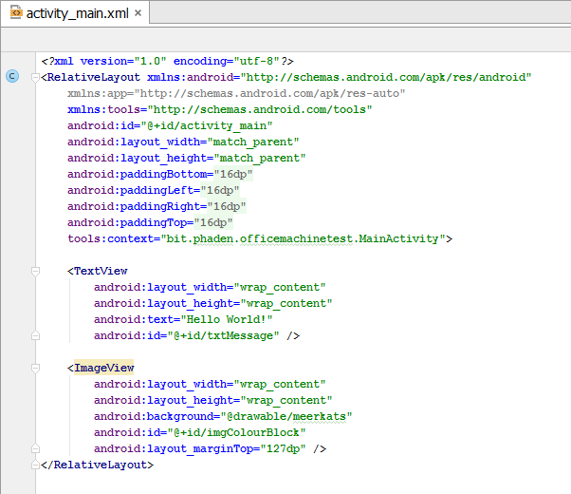
Screen Widgets
Notes:
There’s the ID value I changed in the Properties window – we’ll look more closely at the syntax in a minute
You can also see the id attribute for the TextView
These screen controls are also assigned resource IDs and included in R.
Let’s find them…

Slide 16
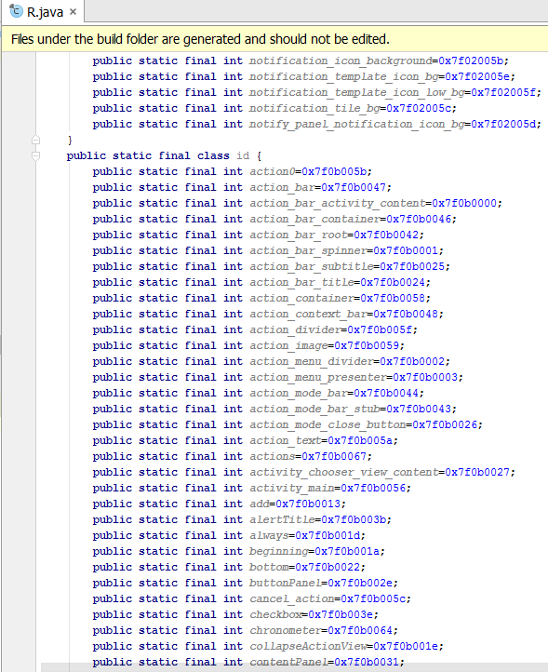
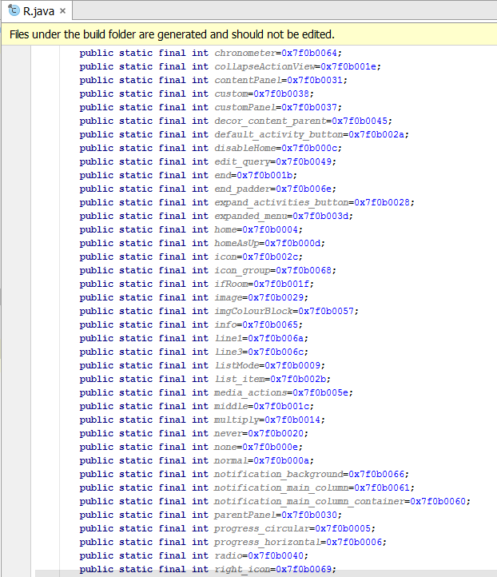
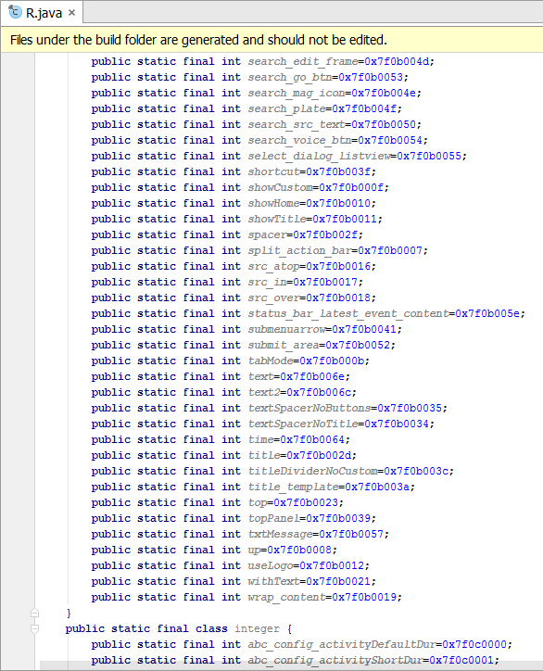
Screen Widgets in R
Notes:
There they are.
When we want to operate on these screen widgets in the java code-behind (for example, to change the contents at runtime) we must do so via their Resource ID.
Fortunately, we don’t have to keep track of these IDs ourselves. When we want one, we will get it from R. The Resource IDs are all static variables of R, so we access them as R.identifyingInformationOfElement.
First, let’s take a look at this Java code-behind we keep talking about.
Then, we will see how we use R to get resource IDs and write code with them.

Slide 17
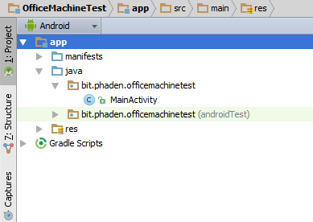
The Java Code
Each Activity is an instance of a new class descended from AppCompatActivity.
When you create an Activity, Android Studio creates a Java file containing your new class’s code.
Notes:
There it is: MainActivity.java
If my activity were named Bob, this would be BobActivity.java
Double-click to open, and you will see the starter code that was generated for you…

Slide 18
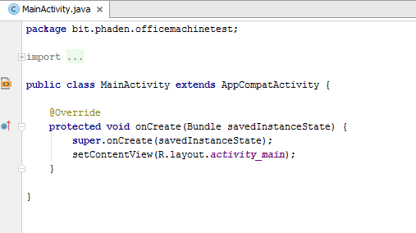
Activity Class Code
Notes:
Here is your new class
Descended from the Android class AppCompatActivity
You have overridden one method of the parent class, onCreate(Bundle savedInstanceState)
This is the event handler for the onCreate event (remember the lifecycle)?
Any code you put in here will be executed when the app is launched.
(Bundle savedInstanceState is used to maintain state if your app gets killed. We meet it later in the semester).
In this default implementation we see only two lines of code.
The first calls the parent’s onCreate, to get all the common work done that AppCompatActivity instances need.
The second statement binds this activity to its layout XML file. Look carefully at how it does this:
It calls a method setContentView. Where does that method come from? You haven’t written it. Yet this class knows it…..→ This method is defined in AppCompatActivity (or one of its ancestors). This is the whole idea when building Android apps. You get dozens of classes with hundreds of methods. You need to learn what you use to get stuff done.
We pass to setContentView, a resource ID, which we get from R. Whose resource ID do you think we are passing? -> res/layout/activity_main.xml
In the xml we were saying @layout/activity_main to get to a resource. The syntax for referring to resources is different in XML and in Java. This shouldn’t surprise you.
If you need to, you can get your other resource constants this way as well: R.color.colorForImageView, etc.
And how do we get the resourceIDs of screen widgets?
Like this…

Slide 19
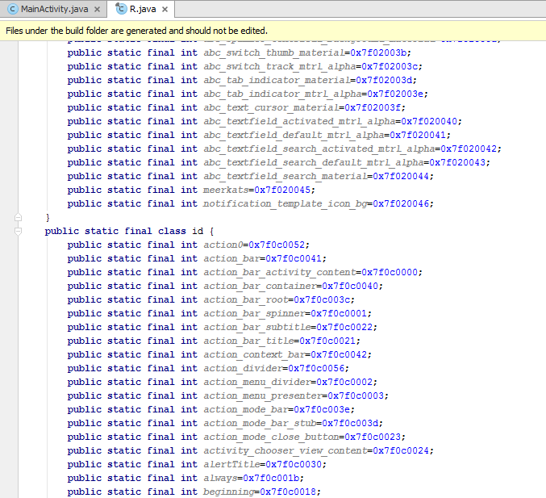
Access a widget resource ID
R.id.imgColourBlock
Notes:
Colours are in R.color.
Layouts are in R.layout.
Screen widgets are in R.id
What do you think these things – color, layout, id – are? → they are inner classes of R. See?
So you can get a resource ID of a screen control. For my ImageView it is 0x7f0c0051.
Can I write code against that number? Use it to change the picture? → No.
All I get from R is the resource ID number.
That was enough for the setContentView method, it wanted an int as its input argument.
To code against an object, that id number isn’t enough. I need the actual object to send method calls to, just like always.
To code against the object, I need a pointer/reference/handle to it, just like in any other programming situation.
So I need a method that will accept a ResourceID and give me a pointer to the actual object...

Slide 20
Get an object pointer from a Resource ID
obj findViewById(int resourceID)
Notes:
Nearly there…
Here is another method that Activity instances inherit. findViewById
This method takes a resource ID, and returns an object.
If you get an object, will the compiler know it is an ImageView? → no.
So we must cast the result of findViewById to the correct class.
In this case, the ImageView is an instance of class ImageView.
(Alt+Enter to import the library)
Here’s what the whole process looks like (often done in a single code statement).
Once you have that reference, you can code to it, just like in C#.

Slide 21
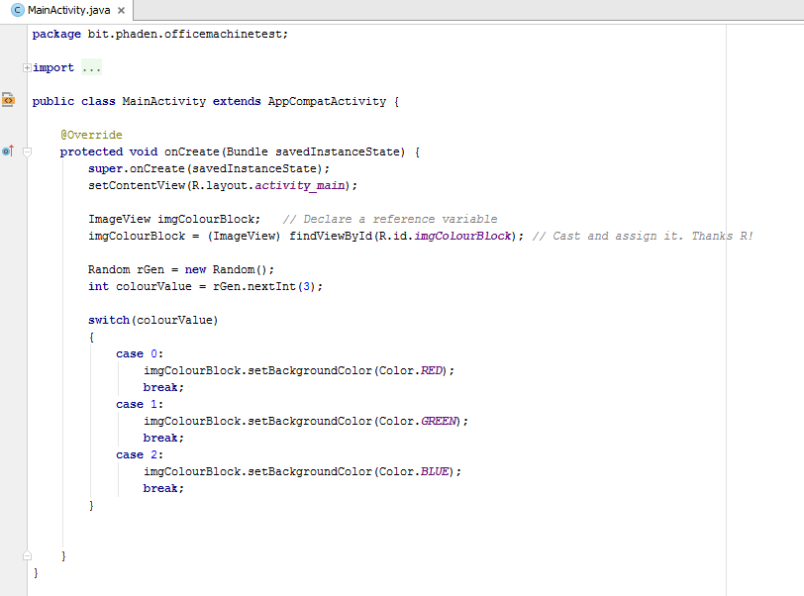
Example
Notes:
How do think this app behaves? -> at startup, it randomly draws a red, green or blue rectangle.
How did I know that ImageViews have a method called setBackgroundColor? How do I know there is a static Android class Color?
AS has excellent code completion. Type the reference, hit . and hunt through what is there
Android has good documentation. Use it. (Not Stack Overflow. Those people will make you stressed.)

Slide 22
Practical 1.2 – The Java Code-Behind

